Slide 1
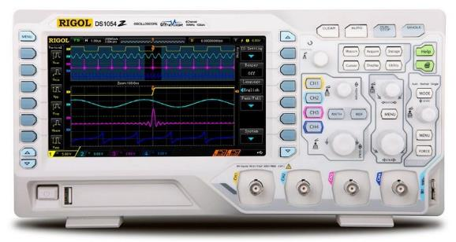
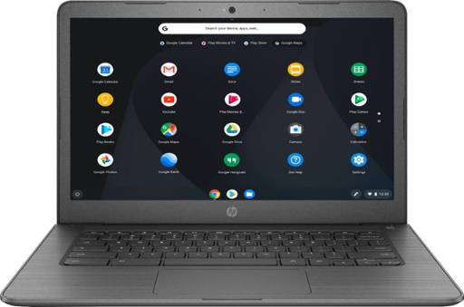


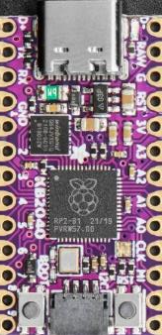
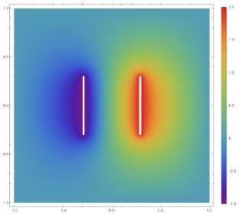
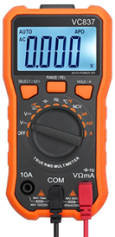

Scientific Computing
Demonstrations
Using Python on a Microcontroller with Sensors
Installing The Software
Dave Biersach
dbiersach@bnl.gov

Slide 2
Preparing for the SciComp Demonstrations
To run the Scientific Computing Demonstrations, students will write software using Python in JupyterLab Notebooks
To properly setup a local Python development environment on your computer, we will use free & open-source tools like Git and Miniconda.
If you already have these applications on your computer, you may not need to reinstall them, but please ensure you are running the most up-to-date versions of these apps
Note: If you already have the full Anaconda distribution on your computer, you do not need to also install Miniconda

Slide 3
Installing the SciComp Demonstration Labs
If running Microsoft Windows, go to slide # 4
If running Apple macOS, go to slide # 13
If running Google Chromebook Linux, go to slide # 23
If running Ubuntu Linux, go to slide # 32
If you run into problems,
see the Troubleshooting Tips
at the end of this slide deck
Note: Your output may not look exactly like the following screen shots.
Use your judgement, go with the flow, and see the big picture here.
Try to understand the intent of these instructions, because your personal computer may be configured slightly different than what is shown here.

Slide 4
Microsoft Windows – Phase 1
You must be running 64-bit Windows 10 (or later) with an Intel CPU and a minimum of 3GB of free disk space
You need local administrator rights on your machine
Accept all default settings for the following installations:
Install PowerShell (64-bit) https://github.com/PowerShell/PowerShell/releases/download/v7.2.1/PowerShell-7.2.1-win-x64.msi
Install Git (64-bit) - https://git-scm.com/download/win
Install Miniconda3 Windows (64-bit) https://repo.anaconda.com/miniconda/Miniconda3-latest-Windows-x86_64.exe

Slide 5
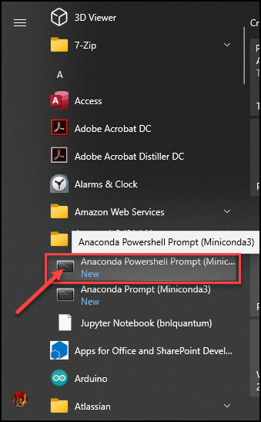
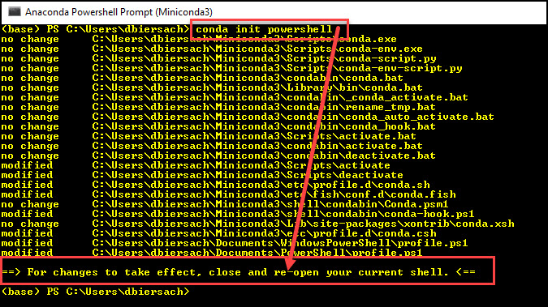
Microsoft Windows – Phase 1
Step 4 - Launch an Anaconda (Miniconda3) PowerShell Prompt:
Step 5 – Enter the command
conda init powershell
Step 6 – Close this PowerShell window!

Slide 6
Microsoft Windows – Phase 2
Start a new PowerShell session and execute these six commands:
Set-ExecutionPolicy RemoteSigned -Scope CurrentUser
conda update -y -n base conda
cd $HOME
git clone https://github.com/dbiersach/scicomp-demos
cd $HOME/scicomp-demos/installers
.\windows-install.ps1

Slide 7
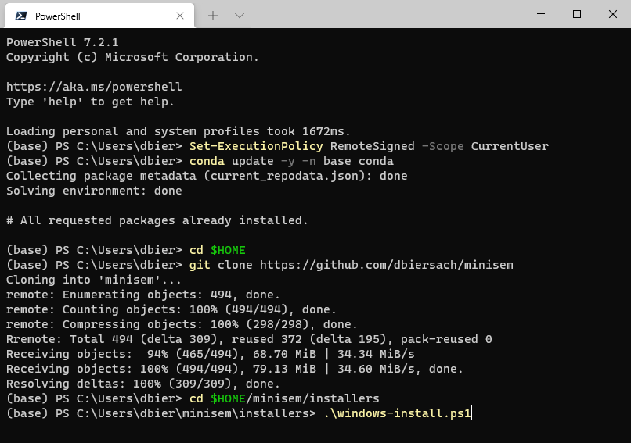
Microsoft Windows – Phase 2 (screenshot)
①
②
③
④
⑤
⑥

Slide 8
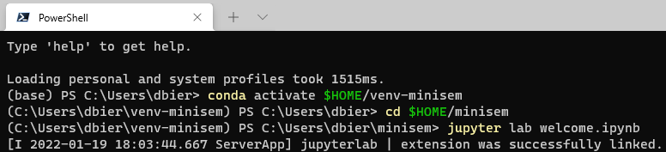
Microsoft Windows – Phase 3
Start a new PowerShell session and execute these three commands:
conda activate scicomp-demos
cd $HOME/scicomp-demos/labs/welcome
jupyter lab welcome.ipynb
①
②
③

Slide 9
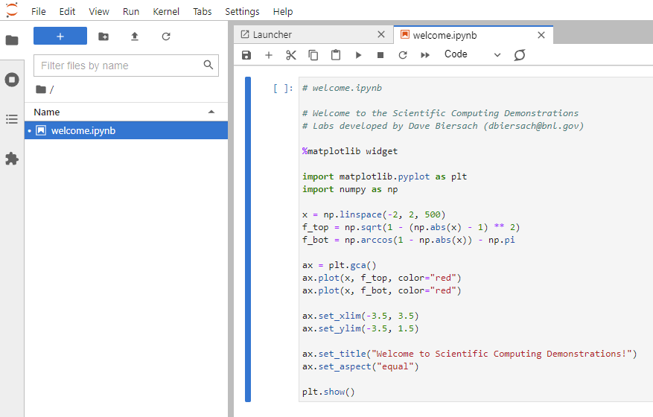
Phase 4 – Run the Welcome Notebook
Click the "Play" button
Double click to open this file

Slide 10
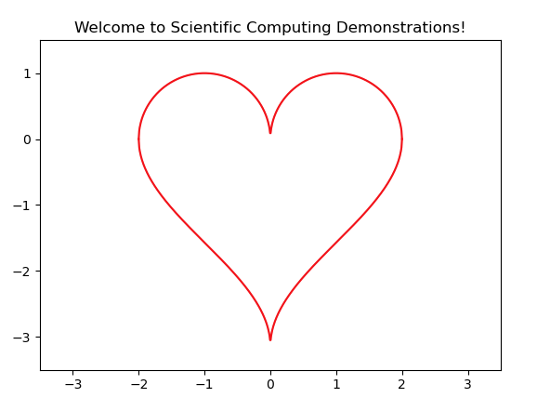
Phase 4 – Success!

Slide 11
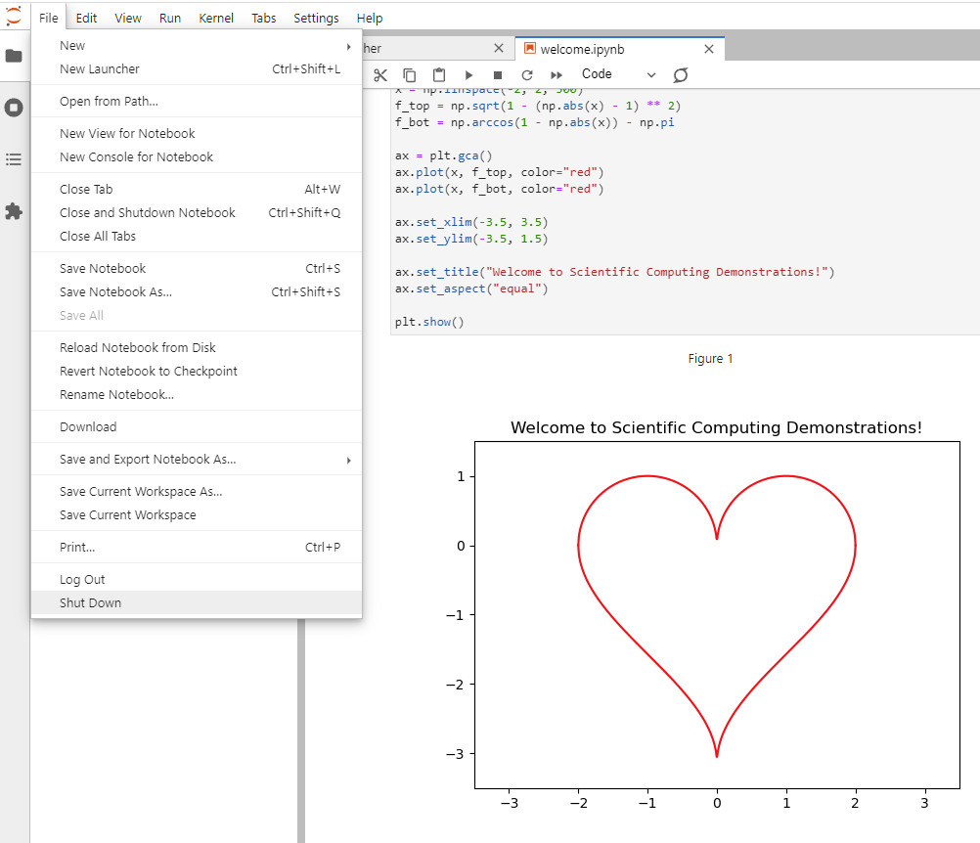
Phase 4 – Shutdown Jupyter
Select File…Shut Down, discard any changes, and then close this web browser window

Slide 12
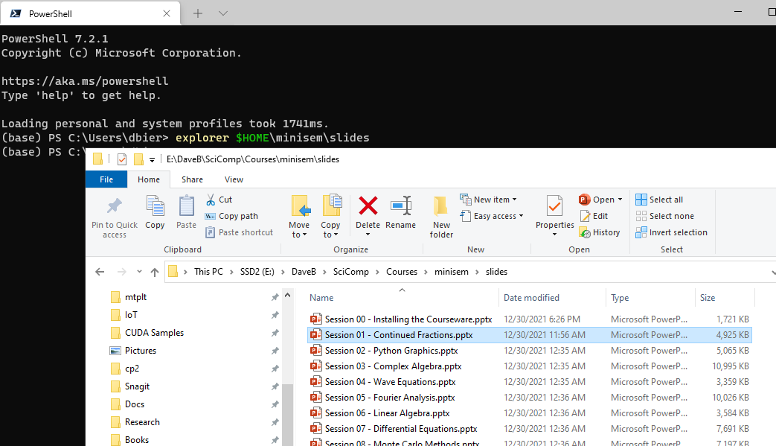
Viewing the Courseware Slides
In a new PowerShell session, execute this command:
explorer $HOME\scicomp-demos\slides

Slide 13
Apple macOS – Phase 1
You must be running 64-bit macOS 11 (or later) with a minimum of 3GB of free disk space
Accept all default settings for the following installations:
Install Git - https://git-scm.com/download/mac (I recommend using the homebrew install method for Git if you can)
Install Miniconda3 for macOS – please read this first: https://conda.io/projects/conda/en/latest/user-guide/install/macos.html - then do this:
If using an Intel CPU: download and run the script Miniconda3 MacOSX 64-bit bash https://repo.anaconda.com/miniconda/Miniconda3-latest-MacOSX-x86_64.sh
If using an M1 CPU: download and run the script Miniconda3 macOS Apple M1 64-bit bash https://repo.anaconda.com/miniconda/Miniconda3-latest-MacOSX-arm64.sh

Slide 14
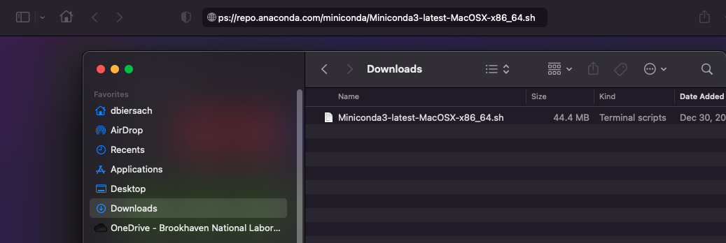
Apple macOS – Phase 1
After clicking on the appropriate script hyperlink in the prior slide (Phase 1 step # 2 a/b) based upon your CPU type, your browser will place the script in your Downloads folder:

Slide 15
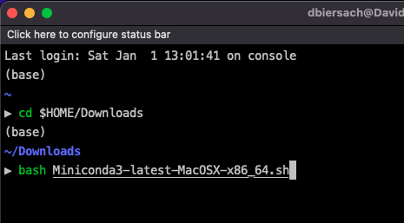
Apple macOS – Phase 1
To run the Miniconda install script that you downloaded,
open a new zsh (iTerm2) session, and type these two commands
cd $HOME/Downloads
bash Miniconda3-latest-MacOSX-x86_64.sh (if on Intel CPU)
or
bash Miniconda3-latest-MacOSX-arm64.sh (if on M1 CPU)
①
②

Slide 16
Apple macOS – Phase 2
After Phase 1 completes, close that zsh window, and then
start a new zsh (iTerm) session and execute these four commands:
conda update -y -n base conda
cd $HOME
git clone https://github.com/dbiersach/minisem
source scicomp-labs/installers/mac-install.sh
Note: If when trying to run conda update… your computer says it cannot find 'conda'…
First, manually locate the conda binary/executable on your filesystem and open a zsh session in that folder.
Then enter the following command: conda init zsh
Then close that zsh session, and restart Phase 2 on this slide

Slide 17
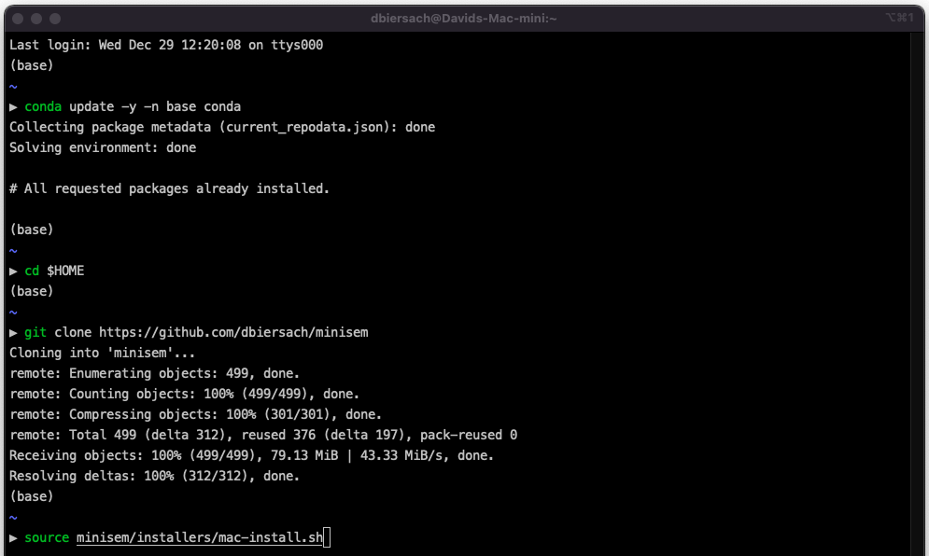
Apple macOS – Phase 2 (screenshot)
①
②
③
④

Slide 18
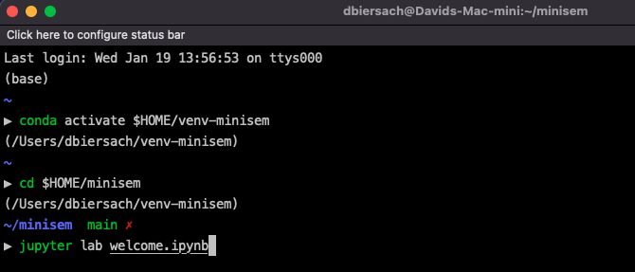
Apple macOS – Phase 3
Start a new zsh (iTerm) session and execute these three commands:
conda activate scicomp-demos
cd $HOME/scicomp-demos/labs/welcome
jupyter lab welcome.ipynb
①
②
③

Slide 19
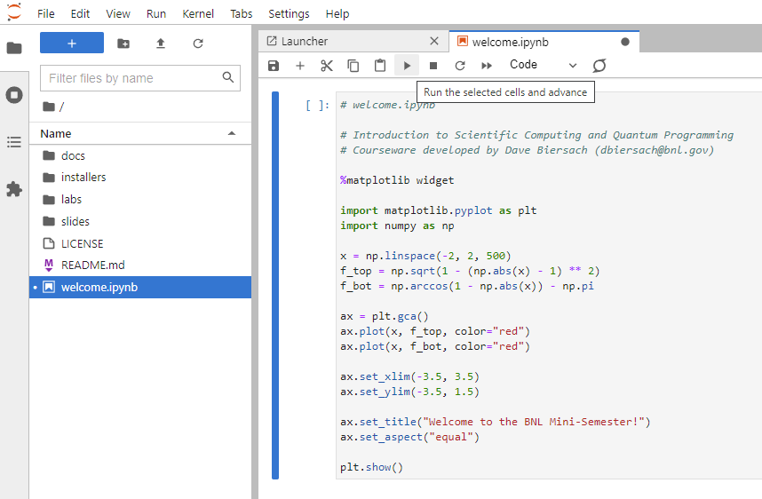
Phase 4 – Run the Welcome Notebook
Click the "Play" button
Double click to open this file

Slide 20
Phase 4 – Success!

Slide 21
Phase 4 – Shutdown Jupyter
Select File…Shut Down, discard any changes, and then close this web browser window

Slide 22
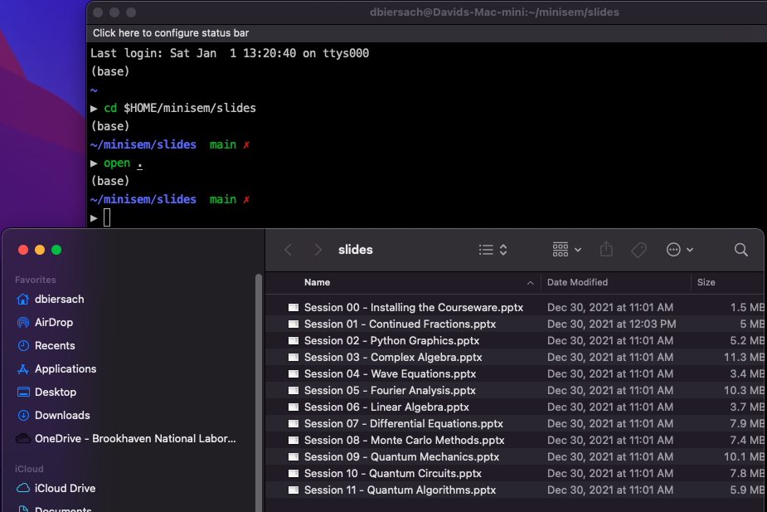
Viewing the Courseware Slides
In a new zsh session, execute thse two commands:
cd $HOME/scicomp-labs/slides
open .

Slide 23
Google Chromebook Linux – Phase 1
You must enable 64-bit Linux on your Chromebook (Crostini) and have a minimum of 3GB of free disk space remaining in the Linux partition
Accept all default settings for the following installations:
Install Git – Enter this command: sudo apt install –y git-all
Install Miniconda3 – Using the built-in Chrome web browser (which runs outside of the Linux Terminal) go to one of these links:
If on an Intel Chromebook, go to this link: https://repo.anaconda.com/miniconda/Miniconda3-latest-Linux-x86_64.sh
If on an ARM Chromebook, go to this link: https://repo.anaconda.com/miniconda/Miniconda3-latest-Linux-aarch64.sh

Slide 24
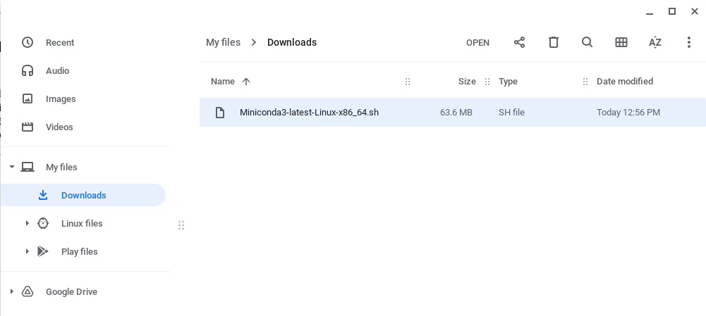
Google Chromebook Linux – Phase 1
After clicking on the appropriate script hyperlink in the prior slide (Phase 1 step # 2 a/b) based upon your CPU type, your browser will place the script in your Downloads folder:
Drag-n-Drop the script file from the Downloads folder to the Linux files folder

Slide 25
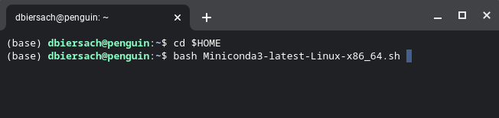
Google Chromebook Linux – Phase 1
To run the Miniconda install script that you downloaded, in the Terminal window, type these two commands based upon your CPU type:
cd $HOME
bash Miniconda3-latest-Linux-x86_64.sh
or
bash Miniconda3-latest-Linux-aarch64.sh
①
②

Slide 26
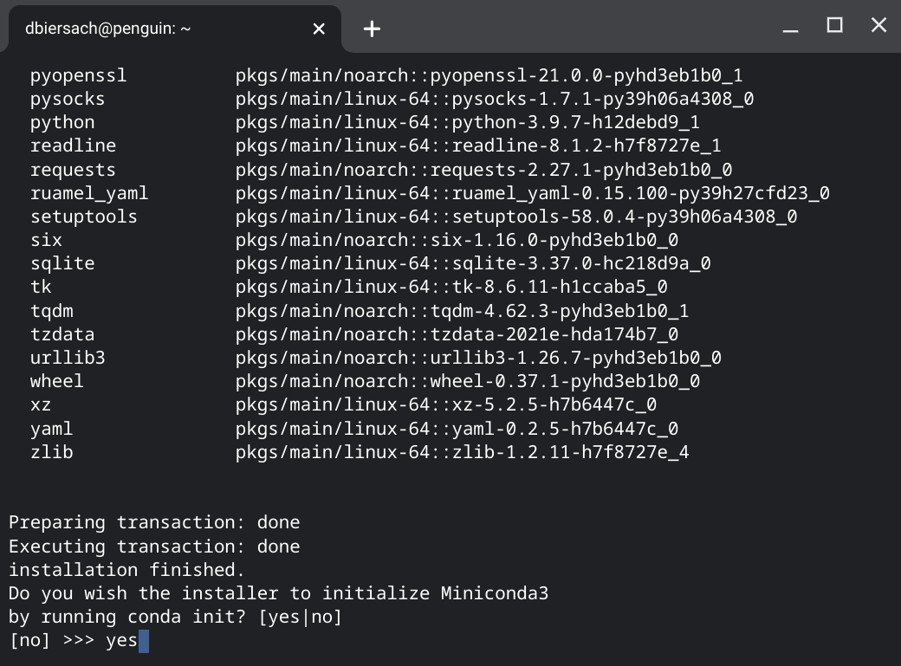
Google Chromebook Linux – Phase 1
Accept the terms of the license, and type yes at the final question.
When the installer finishes, close this Terminal Session:
②
①

Slide 27
Google Chromebook Linux – Phase 2
Open a new Terminal session and execute these four commands.
When the installer finishes, close this Terminal Session:
conda update -y -n base conda
cd $HOME
git clone https://github.com/dbiersach/scicomp-demos
source scicomp-demos/installers/chromebook-install.sh
Note: If when trying to run conda update… your computer says it cannot find 'conda'…
First, manually locate the conda binary/executable on your filesystem and open a Terminal session in that folder.
Then enter the following command: conda init bash
Then close that Terminal session, and restart Phase 2 on this slide

Slide 28
Google Chromebook Linux – Phase 3
Open a new Terminal session and execute these four commands:
conda activate scicomp-demos
cd $HOME
cd scicomp-demos/labs/welcome
jupyter lab

Slide 29
Phase 4 – Run the Welcome Notebook
Click the "Play" button
Double click to open this file

Slide 30
Phase 4 – Success!

Slide 31
Phase 4 – Shutdown Jupyter
Select File…Shut Down, discard any changes, and then close this web browser window

Slide 32
Ubuntu Linux – Phase 1
You must be running 64-bit Ubuntu 18.04 (or later) with a minimum of 3GB of free disk space
Accept all default settings for the following installations:
Install Git – https://git-scm.com/book/en/v2/Getting-Started-Installing-Git (I recommend using 'sudo apt install git-all')
Install Miniconda3 for Linux – please read this first: https://docs.conda.io/projects/conda/en/latest/user-guide/install/linux.html - then do this:
If on an Intel PC: download and run the script Miniconda3 Linux 64-bit https://repo.anaconda.com/miniconda/Miniconda3-latest-Linux-x86_64.sh
If on an ARM PC: download and run the script Miniconda3 Linux-aarch64 64-bit https://repo.anaconda.com/miniconda/Miniconda3-latest-Linux-aarch64.sh

Slide 33
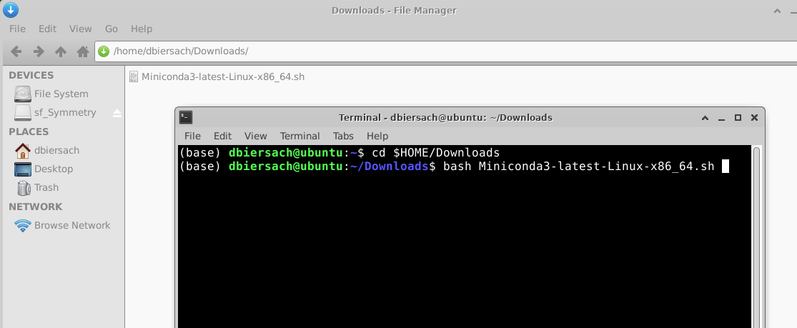
Ubuntu Linux – Phase 1
To run the Miniconda install script that you downloaded,
open a new Terminal session, and type these two commands
cd $HOME/Downloads
bash Miniconda3-latest-Linux-x86_64.sh
①
②

Slide 34
Ubuntu Linux – Phase 2
Start a Terminal session and execute these four commands:
conda update -y -n base conda
cd $HOME
git clone https://github.com/dbiersach/scicomp-demos
source scicomp-demos/installers/ubuntu-install.sh
Note: If when trying to run conda update… your computer says it cannot find 'conda'…
First, manually locate the conda binary/executable on your filesystem and open a Terminal session in that folder.
Then enter the following command: conda init bash
Then close that Terminal session, and restart Phase 2 on this slide

Slide 35
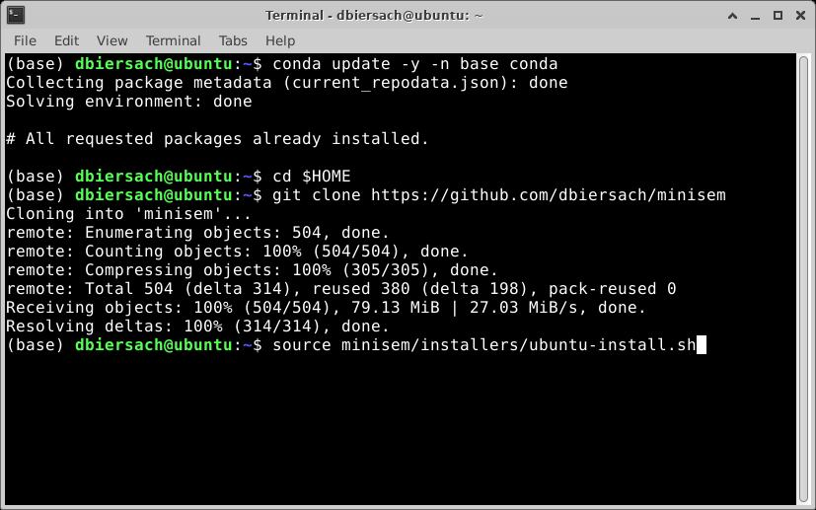
Ubuntu Linux – Phase 2 (screenshot)
①
②
③
④

Slide 36
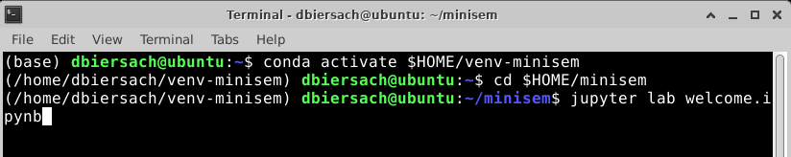
Ubuntu Linux – Phase 3
Start a new Terminal session and execute these three commands:
conda activate scicomp-demos
cd $HOME/scicomp-demos/labs/welcome
jupyter lab welcome.ipynb
①
②
③

Slide 37
Phase 4 – Run the Welcome Notebook
Click the "Play" button
Double click to open this file

Slide 38
Phase 4 – Success!

Slide 39
Phase 4 – Shutdown Jupyter
Select File…Shut Down, discard any changes, and then close this web browser window

Slide 40
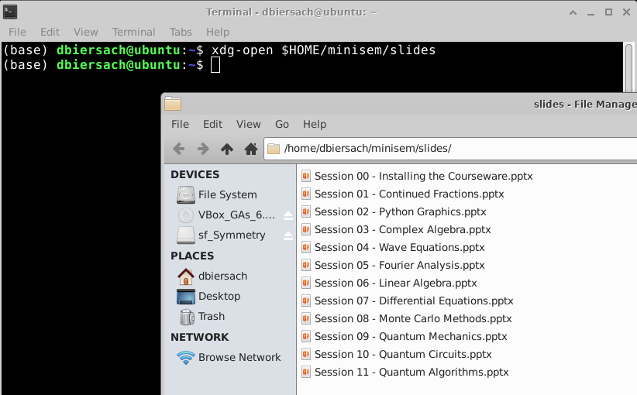
Viewing the Courseware Slides
In a new Terminal session, execute this command:
xdg-open $HOME/scicomp-demos/slides

Slide 41
Troubleshooting Tip #1
If you are in a PowerShell or Terminal (bash/zsh) session, and when trying to run conda activate scicompdemos your computer reports it cannot find 'conda'…
Manually locate the conda binary/executable on your filesystem and open a terminal session in that folder. Then type one of the following commands, based upon your platform:
For Microsoft Windows: conda init powershell
For Apple macOS: conda init zsh
For Chromebook Linux or Ubuntu: conda init bash
The command 'conda init' will update your shell's path to include where the conda executable (program) can be located

Slide 42
Troubleshooting Tip #2
If you try to open a Jupyter Lab Notebook file (such as welcome.ipynb) and your default browser opens but then reports "file not found" or "access denied"…
Open a terminal session and type these two commands:
jupyter lab --generate-config
echo 'c.ServerApp.use_redirect_file = False' >> $HOME/.jupyter/jupyter_lab_config.py
The last command above appends an option to the end of the jupter_lab_config.py file to ensure ensure your browser can open a notebook file following the initial page redirection requested by the local Juptyer web server

Slide 43
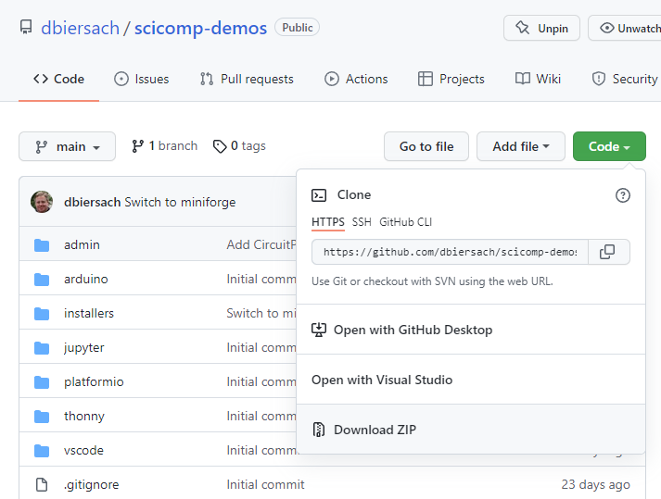
Manually Downloading the SciComp Demos
The SciComp Demonstrations software can be
manually downloaded as a single ZIP file from
https://github.com/dbiersach/scicomp-demos

